Slide 1
Git and Github

Slide 2
Version Control System
Keep versions of files/ directory
Document the changes with descriptive messages
Display differences
Coordinate changes between you and your team (what, who, when changes happen )
Why to use vision control:
To get back and furth between the code versions
To share code and project files with development team
Example:
Git, Github, GitLab and SVN

Slide 3
Git/Github
Git is a version control system that lets you manage and keep track of your source code history
GitHub is a cloud-based hosting service that lets you manage Git repositories.

Slide 4
Download and install git
Download Git:
https://git-scm.com/download/win (default setting) after installing choose lunch Git Bash
On git Bash type:
To ensure it git is working type: git ➔ list of commands
If you got an error message something went wrong in the installation
To know the version type: version ➔ the version is displayed
To explain a command type: git help <command> ➔ explanation on the web browser

Slide 5
Configuring Git
To se the configuration: Git config -- list
It is important to (User Name and email)
To change user name: Git config - -global user.name “kawther”
To change email: Git config - -global user.email “ksaeedi@kau.edu.sa”

Slide 6
First Git Project
Point git to the directory Use:
Cd “C:/Users/kawth/Desktop/NewGitProject”
To initiate the project use: Git init
To know if the git is working correctly on this directory use:
Git status

Slide 7
Basic workflow of Git
Any file on the directory is not tracked unless you tell git track it: (you know the status: git status)
Git workflow have 3 area:
1-Working directory (the folder) untracked. To track the file use:
git add <file name>
2-Staging area (tracked) Used. All the changes are tracked
To document a version of the project use:
Git commit –m “ descriptive message of the changes”. This mean the file is committed to the repository
To add all the files use :git add . (the dot will add all the charges moved to the staging area)
However better to do it one by one or sections add use descriptive message
If -m is not specified a the unix file will open asking you to write a message. To close Esc Button and then write :wq or :wq! and then Enter to close the unix file.
3- Repository
To see all the versions committed use: git log➔ who, when, what commented and message. Each commit have unique ID

Slide 8
Reviewing the changes in Git
Git diff with many options
1- Working directory and repository : Git diff
2- Different versions of the commits: Git diff log
3- Staging area and repository: Git diff

Slide 9
Remove
Git rm –f file name

Slide 10
Tagging (local part)
To specify a specific time throughout the project maybe milestones
Why to use it
Creation of important point of the project
To mark different releases of the project
To create a tag: Git tag virsion
To list all the tags: To Git Tag
Git Tag –list arrange alphabetically
Search for a tag: Git tag -l “start with”
Delete Tag

Slide 11
Unstaging files in git
We use add command to add file on a staging area use:
git restore --staged “file name”

Slide 12
Modifying and revert modification files in Git
Restores files on your working directory
If you change file, then you want to go back to resote the file lile last commit use the command:
git restore <file>

Slide 13
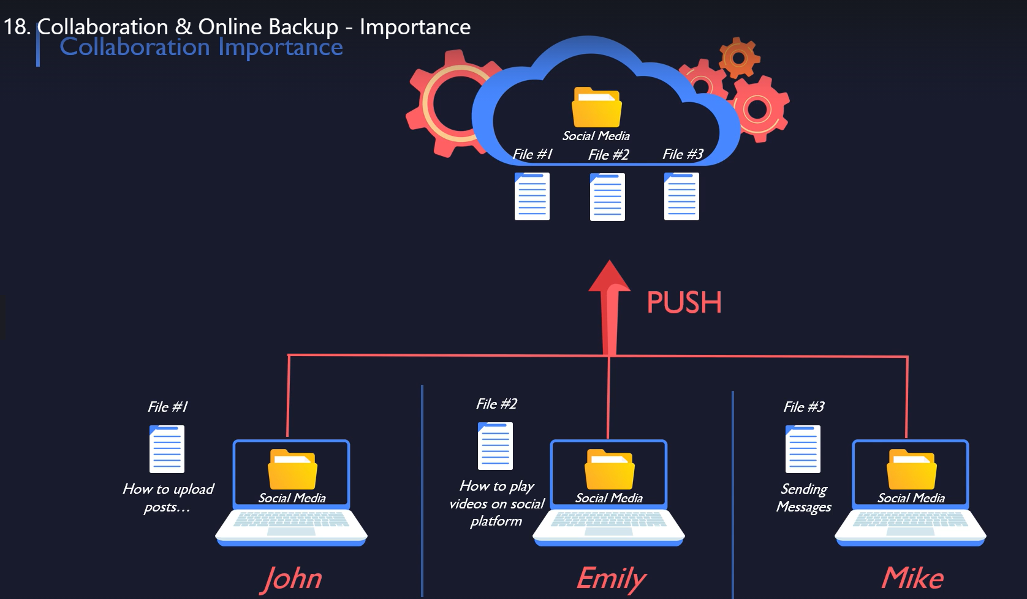
GitHub,
Largest community of developer backed by Microsoft
Collaboration
Access remotely
Remote backup
Create an account
https://github.com/

Slide 14
Quickly exploring your Github
Repository
Explore Git Hub functionality: other project you can learn from.
  The default is feed related to the area you chose as interest
  You can search by typing
  You can search by topics

Slide 15
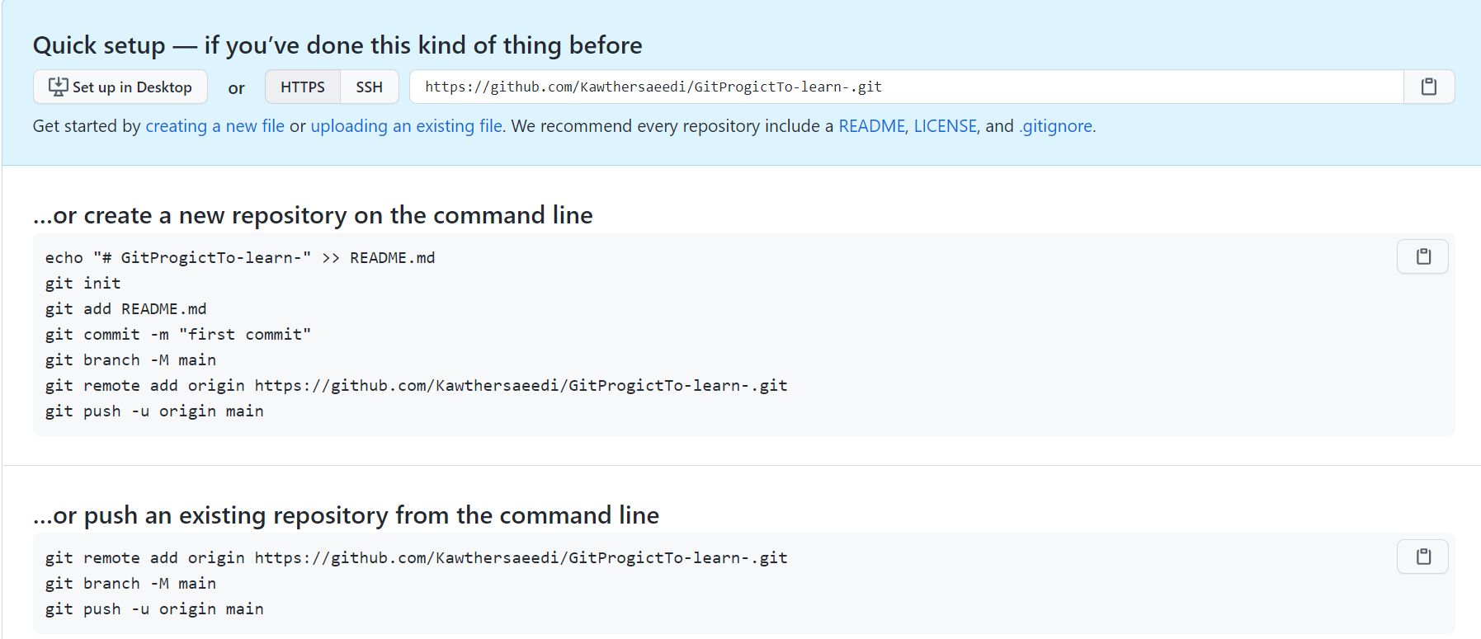
Creating repository in Github
From New Repository … fill in the form
To create new repository
To existing repository

Slide 16
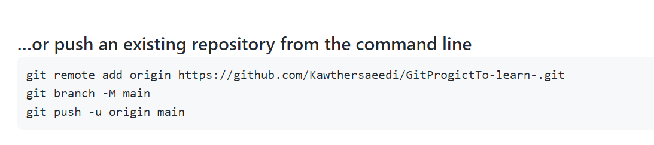
Pushing repository from local machine to git hub
This is the URL of the remote directory
After run remote add
$ git remote ➔ to get the origin (default name online)
$ git remote –v ➔ to get the Fetch to local and push to online URL
$ git push origin master (to push from local to remote)

Slide 17
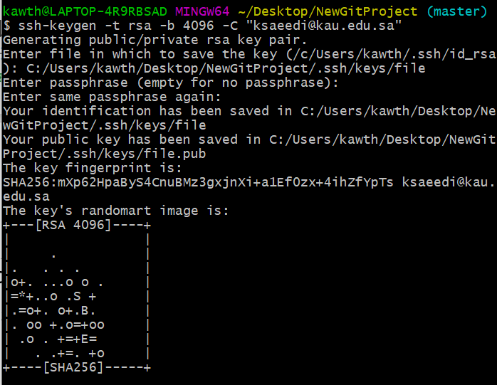
SSH process in General
$ ssh-keygen -t rsa -b 4096 -C "your_email@example.com"
SSH stand of Secure Shell to safely connect and work remotely.
It is based on Public and privet key using RSA encryption
We need to use the key to push and Fetch the files between local Git Repo and Remote GitHub
So First Step is to generate ssh key on your LOCAL Repo:
$ ssh-keygen -t rsa -b 4096 -C "your_email@example.com"
add the file directory if you want to change the default then leave the rest empty ➔ RSA key generated as shown
Two files are generated inside the .ssh folder (id_rsa and id_rsa.pub)
To add the key
$ eval $(ssh-agent –s) ➔ Agent paid 2177
$ ssh-add id_rsa ➔ Identity added: id_rsa (ksaeedi@kau.edu.sa)
To copy the key:
$ clip <id_rsa.pub>
To add it on GitHub
Repo > setting> SSH & GPG key > new key (add discerption and pays the key
Now you are ready to push the local repo from the Repo directory use:
$ git push origin master
On GitHub you will see the complete Repo with history of commit

Slide 18
Github Project and file
Project level buttons
  Watch: you get notification whenever there is an update
  Star: bookmark
  Issues: to do list, enhancement, questions, bug …etc
File level buttons
  Raw: to show the original file as it written without git format
  Blame: to know who wrote or Edit this file
  History: History of commit of this particular file

Slide 19
Gitignore
To not track files specific files.
Get should read the instruction of ignoring
To create ignore file write:
$ Touch .gitignor
FolderName/ (ignore this directory)
*.txt (all the txt files )
Check the gitegnore templet rule
It is recommended to share and comment .gitignore file with the team to know the ignore rules

Slide 20
Github Fork Functionality
It clone a copy of an oline reposit to be able to edit and work on an issue.
You can work on it edit file, create new once and commit the changes to your own github copy
Sharing the modification with the owner. Use create pull request
Fark is not enough to compile and run the new changes it is only to edit static version of the project. The solution to that to use clone

Slide 21
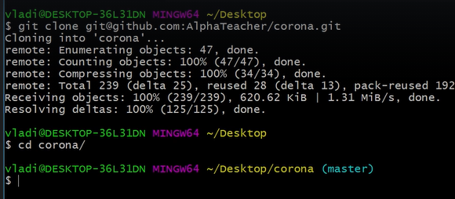
Clone from remote repository
On github forked project go to code copy the URL
On local git go to the directory and type
$ git clone copied URL
Move to the folder
Cd folderName/
Do modification, add, commit locally
You can also push the changes to github use:
$git push origin master
To change the changes to the inital authors you can use create pull request

